Slide 1

THOTH
Smart Museum Guide Robot
Graduation Project I — Final Presentation
Computer Engineering Department · AASTMT
Supervised by Dr. Marwa Elshenawy · Dr. Mohamed Elhabrouk
Presented by Leena Gouda – Nayrouz Ahmed – Habiba Ghoneim – Youssef Waleed – Saged Khaled – Mohamed Eldairouty
2026 - 2027
THOTH — Smart Museum Guide
01 / 00

Slide 2
01
Introduction
THOTH — Smart Museum Guide
02 / 00

Slide 3
Introduction
In its first month, the Grand Egyptian Museum became the third most-visited museum in the world — drawing up to 19,000 visitors a day.
About 45% of those visitors come from outside Egypt, often without a personal guide. Audio handsets play the same one-language script to a child and a researcher, can't answer a follow-up question, and leave international visitors without usable narration.
THOTH is an autonomous robot built for this gap: it walks visitors through the halls, talks with them in their own language, reads their mood to adjust how it speaks, and is accessible by design.
Autonomous Navigation
LLM Conversation
Mood + Age Awareness
Multilingual (EN · AR · FR …)
THOTH — Smart Museum Guide
03 / 00

Slide 4
02
Problem Statement
THOTH — Smart Museum Guide
04 / 00

Slide 5
Problem Statement
Not Enough Human Guides
Language Barriers
Museums can't staff a personal guide for every visitor. At peak hours most people walk through with no narration at all.
Tours run in one or two languages. International visitors get a leaflet and silence.
One Script for Everyone
Accessibility Gaps
Audio guides play the same monologue to a curious 9-year-old, a researcher, and a passing tourist.
Visitors who are deaf, blind, in wheelchairs, or non-native speakers are treated as edge cases, not as the default.
These are not minor inconveniences — they affect millions of museum visits every year.
THOTH — Smart Museum Guide
05 / 00

Slide 6
03
Aims & Objectives
THOTH — Smart Museum Guide
06 / 00

Slide 7
Aims & Objectives
01
Build an autonomous robot that navigates a real museum floor with live obstacle avoidance.
02
Hold a real conversation in English, Arabic, French, and more — by text or voice.
03
Read the visitor's mood and age in real time, and adjust tone and pace.
04
Ship a production-grade touchscreen web app: exhibit browsing, map, chat, settings.
05
Treat accessibility as default: captions, large fonts, audio narration, RTL support.
06
Design it customizable — one system, many venues: museums, airports, hospitals, expos.
THOTH — Smart Museum Guide
07 / 00

Slide 8
04
Literature Survey
THOTH — Smart Museum Guide
08 / 00

Slide 9
Literature Survey
Authors & Year | Key Finding | Relation to THOTH
Velentza et al., 2020 | Robots outperform audio guides in knowledge retention | Justifies physical robot over screen/audio solution
Iio et al., 2020 | Proactive museum robot — 94.74% visitor satisfaction | Validates THOTH's proactive navigation model
Rosa et al., 2024 | Full ROS museum robot deployed in 2 real venues | Proves full system architecture is deployable
Grady et al., 2024 | ROS2 + Nav2 + LLM museum robot in live museum | Validates THOTH's exact tech stack
Garello et al., 2025 | LLM + SLAM museum robot tested with 34 visitors | Current state-of-the-art — THOTH builds on this
Saleem et al., 2025 | Mecanum + LiDAR + ROS museum robot | Validates THOTH's hardware choices
Vasic et al., 2024 | LLM-personalized museum tour guide | Validates LLM personalization approach
No existing system combines autonomous navigation, conversational LLM, real-time mood / age recognition, and full multilingual support. THOTH does.
THOTH — Smart Museum Guide
09 / 00

Slide 10
05
Proposed Model
THOTH — Smart Museum Guide
10 / 00

Slide 11
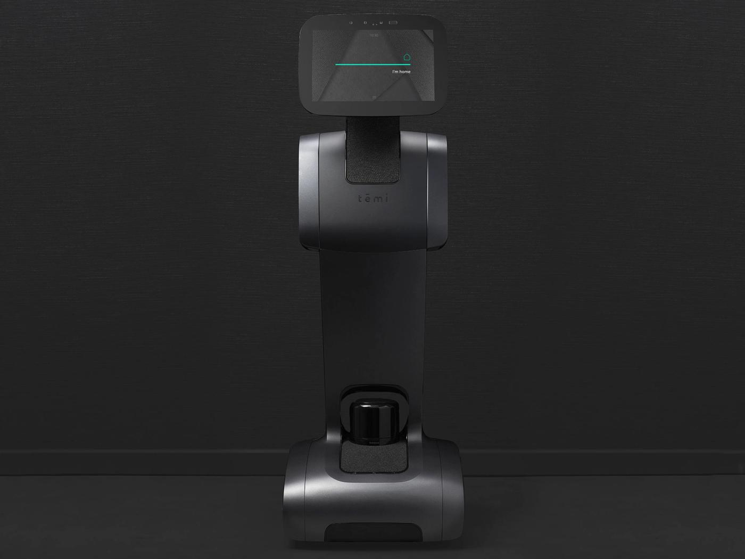
Hardware design
Inspired by Temi a home assistant robot THOTH is composed of multiple hardware modules
THOTH — Smart Museum Guide
11 / 00

Slide 12
USB Camera + Mic
Hardware design
Touch Screen
Movement Module: consisting of Arduino , Motor drivers , DC Motors + wheels
Interactivity module: Touch Screen + Mic + U
ALL modules and components connected to the Central mini PC ( probably a laptop used for Project II prototype) that implement the ROS2 system
Dimensions chosen to be 130cm height and 45cm width to be in a comfortable eye level display
130 cm
Mini PC
Lidar
Movement Module
THOTH — Smart Museum Guide
45cm
11 / 00

Slide 13
Hardware design
Electrical SID
THOTH — Smart Museum Guide
11 / 00

Slide 14
System Architecture
Sensors & Hardware
LiDAR · RGB-D · Mic · Speaker
Web App
React · FastAPI · PostgreSQL
Navigation
ROS 2 · Nav2 · SLAM
AI Conversation
Gemini LLM · Whisper · edge-tts
Power & Motors
DC motors · drivers · LiPo
Vision
OpenCV · DeepFace (mood + age)
THOTH — Smart Museum Guide
11 / 00

Slide 15
ROS 2 — Node & Topic Graph
ROS node
Process group
Runtime communication: sensing → Nav2 navigation → web-app docent stack
Topic (pub → sub)
LiDAR Driver
Project 1
Camera
Project 2
/scan
/image_raw
Nav2 Stack
Age Node
Mood Node
AMCL
Map Server
/age
/mood
Planner +
Controller
BT Navigator
/amcl_pose
Docent Stack
Web App + LLM
FastAPI · React · Gemini
Tour Coordinator
/goal_pose
/cmd_vel
Serial Node
Prompt Builder
"age + mood + exhibit"
Database /
Exhibit Loader
serial
Arduino + Motors
THOTH — Smart Museum Guide
12 / 00

Slide 16
Project I — What We Built
Six independent modules, all ready to integrate in Project II.
Full-Stack Web App
Conversational AI & Voice
Mood Recognition
Mohamed Abdallah Eldairouty
Leena Gouda
Nayrouz Ahmed
React + FastAPI + PostgreSQL. The integration layer that ties together the LLM chat, vision models (mood + age), navigation, and simulation map — one demoable system.
LLM pipeline (Gemini) + Whisper STT + edge-tts TTS. Multilingual in three languages, exhibit-aware prompts.
Real-time facial emotion recognition using OpenCV and a deep-learning model. Streams predictions to the robot brain.
Age Recognition
Simulation & Navigation
Hardware Prototype
Youssef Waleed
Saged Khaled & Youssef Waleed & Habiba Amr
Habiba Amr & Leena Gouda
Real-time age estimation from a single camera frame. Used to tune the robot's tone for kids vs. adults.
Full Gazebo museum environment and ROS 2 navigation stack — used to validate routes before hardware.
Working campus delivery robot — proves the base, motors, and control loop in real corridors.
THOTH — Smart Museum Guide
13 / 00

Slide 17
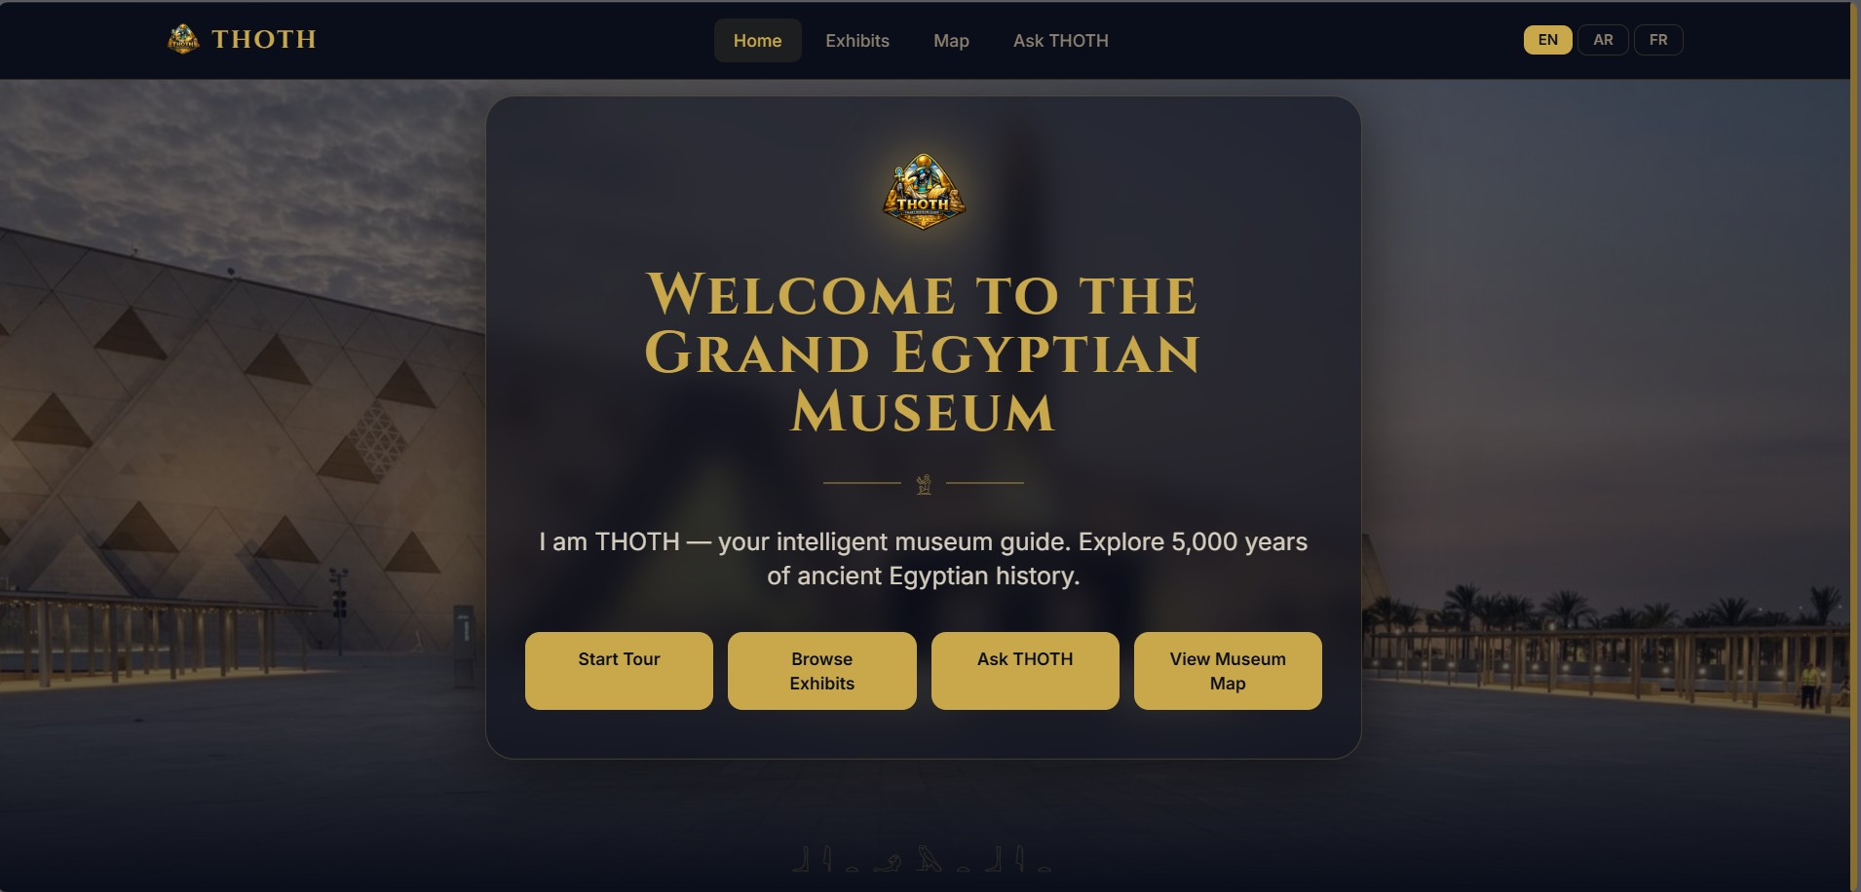
Touchscreen Web Application
Mohamed Abdallah Eldairouty - Full-Stack Web Application
The visitor's window into the museum.
Production-grade architecture, not a mock-up.
Same code runs on a kiosk, a phone, or the robot.
Multilingual content resolved server-side — frontend stays simple.
All AI calls go through the backend — easy to swap providers.
Wires the LLM chat to the vision models — THOTH adapts how it speaks to who's in front of it (mood + age).
Connects to the same ROS 2 navigation and simulation we built.
THOTH home page — running locally against the real backend.
THOTH — Smart Museum Guide
14 / 00

Slide 18
Web App — Architecture & Pages
Stack
Pages
Frontend
React · Vite · TypeScript · Tailwind
Home
Welcome, language switch, quick actions
API Layer
FastAPI · Pydantic
Exhibits
Search · filter by hall, era, category
Exhibit Detail
Story, media, audio narration, chat link
Service Layer
Business logic · AI orchestration
Museum Map
Live robot marker, route preview
Data Layer
SQLAlchemy · Alembic · PostgreSQL
Ask THOTH
Text + voice chat, plays back TTS reply
AI Services
Gemini · Whisper · edge-tts
Settings
Language, font size, captions, audio
THOTH — Smart Museum Guide
15 / 00

Slide 19
Speech Interaction Architecture
Leena Gouda - LLM · Speech-to-Text · Text-to-Speech
Every visitor interaction follows a fixed 3-stage pipeline:
Visitor speaks robot speaks
Each stage feeds directly into the next — errors propagate forward
All three components share one critical requirement: strong Egyptian Arabic + English support
All three are free — zero cost for development and demos
Whisper Large V3
Speech-To-Text
Gemini 2.5 Flash
Large Langauage Model
ElevenLabs Multilingual V2
Text-to-Speech
🎤
🔊
THOTH — Smart Museum Guide
16 / 00

Slide 20

Speech To Text (STT)
Leena Gouda - LLM · Speech-to-Text · Text-to-Speech
OpenAI Whisper Large V3
Why we chose it:
Free and open-source — no API costs, runs fully locally on-device
Designed for noisy environments — critical for a busy museum with ambient sound
Runs offline — no internet dependency for this stage of the pipeline
THOTH — Smart Museum Guide
17 / 00

Slide 21
Speech To Text (STT)
Leena Gouda - LLM · Speech-to-Text · Text-to-Speech
Alternatives we evaluated and rejected:
Alternative | Why Rejected
Deepgram Nova-3 | Paid API, weak Arabic dialect documentation, no offline mode
Google Chirp 2 | Most expensive option ($16/1000 min), worst accuracy-to-cost ratio, cloud-only
AssemblyAI Universal-2 | Paid, Egyptian colloquial Arabic performance undocumented in literature
Azure Speech (cloud) | Paid, cloud-dependent, same concerns as Chirp 2
Facebook MMS | Not optimized for real-time interactive applications
Amazon Transcribe | No free tier for Arabic, limited dialect support
THOTH — Smart Museum Guide
18 / 00

Slide 22

Large Language Model (LLM)
Leena Gouda - LLM · Speech-to-Text · Text-to-Speech
Google Gemini 2.5 Flash
Why we chose it:
Arabic and English are both Tier-1 supported languages — not an afterthought
Understands mid-sentence code-switching (visitor mixes Arabic and English naturally)
Optimized for speed — responds in 1–2 seconds, essential for real-time conversation
Behavior fully controllable through a system prompt that defines the robot's identity, language rules, answer length, and topic constraints
System prompt is: A fixed instruction block that wraps every visitor question — invisible to the visitor. It transforms a general AI into THOTH, a named museum guide that speaks the visitor's language, stays on topic, and keeps answers concise. This is how real-world AI applications are built — not by training new models, but by carefully instructing existing ones.
THOTH — Smart Museum Guide
19 / 00

Slide 23
Large Language Model (LLM)
Leena Gouda - LLM · Speech-to-Text · Text-to-Speech
Alternatives we evaluated and rejected:
Alternative | Why Rejected
GPT-4o | Paid API after free tier, higher cost per token, no advantage in Arabic over Gemini
Claude (Anthropic) | No substantial free tier for development, Arabic support less documented
Llama 3.1 8B (local) | Requires GPU to run at acceptable speed — not feasible on current hardware
Qwen3-235B | Far too large for any local deployment, impractical for this project stage
Jais 70B | Arabic-specialized but 70B parameters — impossible to run locally
THOTH — Smart Museum Guide
20 / 00

Slide 24

Text To Speech (TTS)
Leena Gouda - LLM · Speech-to-Text · Text-to-Speech
ElevenLabs Multilingual v2
Why we chose it:
Highest voice naturalness among all evaluated options — visitors described it as the most "comfortable" and human-like
Multilingual model handles Arabic and English in the same voice without switching engines
MOS (Mean Opinion Score) above 4.0 across all content categories — consistently outperforms Azure in naturalness evaluations (Cartesia AI, 2025)
Free tier available — sufficient for development and demo purposes
THOTH — Smart Museum Guide
21 / 00

Slide 25
Text To Speech (TTS)
Leena Gouda - LLM · Speech-to-Text · Text-to-Speech
Alternatives we evaluated and rejected:
Alternative | Why Rejected
Edge-TTS (Shakir) | Mispronounced Egyptian colloquial words — "اتبنت" and "Tutankhamun" rendered with MSA phonology, not Cairene dialect. Root cause: Shakir is trained on MSA, not Egyptian colloquial Arabic
gTTS (Google TTS) | Robotic quality, no gender control for Arabic — eliminated immediately
Egyptian dialect models (HuggingFace) | Specifically trained on Egyptian colloquial Arabic which would have been ideal, but require GPU inference — not feasible on current hardware. Flagged as a Phase 2 upgrade path
Azure TTS (cloud API) | Paid after free credits, MOS scores below ElevenLabs, same MSA phonology limitations as Edge-TTS Shakir
Fish Speech V1.5 | Egyptian Arabic voice quality undocumented; no peer-reviewed validation for Arabic dialect
THOTH — Smart Museum Guide
22 / 00

Slide 26
Mood Recognition
Nayrouz Ahmed - Real-Time Facial Emotion Recognition
What is Mood Recognition?
Technical Stack
THOTH reads the visitor's facial expression in real time using the device camera.
The detected emotion is streamed via ROS 2 to the docent stack, which adjusts tone, vocabulary, and pacing — so a visibly bored child and an excited researcher both get a response tailored to them.
Framework
PyTorch | Transfer Learning from ImageNet
Vision
OpenCV face detection | input resized to 224x224
Models Trained
EfficientNet-B2 on RAF-DB — 78.29% accuracy
EfficientNet-B0 on FER2013 — 67.16% accuracy
Output
7-class softmax → /mood ROS 2 topic
Angry | Disgust | Fear | Happy | Sad | Surprise | Neutral
THOTH — Smart Museum Guide
23 / 00

Slide 27
Dataset Comparison — RAF-DB vs FER2013
Nayrouz Ahmed - A comparative study across two datasets
RAF-DB — Real-world Affective Faces Database
FER2013 — Facial Expression Recognition 2013
15,339 images | 7 emotion classes | color, ~100x100 px
In-the-wild photos: diverse lighting, pose, age, ethnicity
Class imbalance: Happy (17x) vs Fear | many classes skewed
Model: EfficientNet-B2 (8.42M params)
Two-stage warmup fine-tune | Double-Dropout head
WeightedRandomSampler | label smoothing = 0.1
35,887 images | 7 emotion classes | grayscale, 48x48 px
Crowd-sourced & noisy | ~10% label errors | ICML 2013
Class imbalance: Disgust only 1.5% (16x less than Happy)
Model: EfficientNet-B0 (5.3M params)
Single-stage partial fine-tune | Dropout(0.5) head
WeightedRandomSampler | AdamW | label smoothing
Final Results
Test accuracy: 78.29%
Train Loss: 0.76 | Val Loss: 0.92
No overfitting — tight train/val gap throughout
Best F1: Happy 0.89, Neutral 0.73
Lowest F1: Fear 0.54, Disgust 0.50 (74 & 160 test samples)
Final Results
Test accuracy: 67.16%
Train Loss: ~1.2 | Val Loss: ~1.0
Mild overfitting — inherent to noisy low-res data
Best F1: Happy 0.87, Surprise 0.78
Lowest F1: Fear 0.54, Sad 0.57 (human ceiling ~65%)
THOTH — Smart Museum Guide
24 / 00

Slide 28
Model Architecture & Training Setup
Nayrouz Ahmed - EfficientNet-B0 Fine-Tuning Pipeline
MODEL PIPELINE
TRAINING SETUP
1 • Input
224×224 px, grayscale → 3-channel (ImageNet compat.)
2 • EfficientNet-B0 Backbone
ImageNet pretrained • features[6:] unfrozen
3 • Custom Classifier Head
Dropout(0.5) → Linear(1280 → 7)
4 • Output
7-class softmax logits (one per emotion)
Optimizer
AdamW • weight decay = 1e-4
Loss
CrossEntropyLoss • label smoothing = 0.1
Learning Rate / Batch / Epochs
LR = 5e-5 • Batch = 32 • Up to 30 epochs
Early Stopping
Patience = 3 • Best val-accuracy checkpoint saved
Sampler
WeightedRandomSampler — balances all 7 classes per batch
THOTH — Smart Museum Guide
26 / 00

Slide 29
Handling Class Imbalance
Nayrouz Ahmed - Three-layer fix for uneven emotion distribution
THE PROBLEM
Both datasets suffer from class imbalance. RAF-DB: Happy has 1,185 test images while Fear has only 74 — a 17× gap across many classes. FER2013: Happy dominates at 25% while Disgust is only 1.5% (547 images) — a 16× gap concentrated in one class. In both cases a naive model learns to predict the majority class and completely ignores rare emotions.
01 • Augmentation
02 • WeightedRandomSampler
03 • Label Smoothing
RandomHorizontalFlip (p=0.5)
RandomRotation (±15°)
RandomAffine + ColorJitter
Avoided vertical flips & aggressive crops to protect natural facial features.
Inverse-frequency class weights
Rare classes (Disgust, Fear) sampled more frequently
Result: all 7 emotions appear ~equally in every training batch (n≈140 per class).
CrossEntropyLoss with smoothing = 0.1
Prevents model from being overconfident on ambiguous expressions
Especially important for Fear / Sad / Angry — which share subtle facial features.
THOTH — Smart Museum Guide
27 / 00

Slide 30
Experiments & Results
Nayrouz Ahmed - Grid Search, Final Tuning, and Per-Emotion Performance
FER2013 — 4-WAY GRID SEARCH (Augmentation • Learning Rate • Batch Size • Dropout)
Config 1: No Aug | LR=1e-4 | BS=32 | Drop=0.3 → 64.8% Config 2: Aug ON | LR=1e-4 | BS=32 | Drop=0.3 → 66.8% (WINNER) Config 3: Aug ON | LR=3e-4 | BS=32 | Drop=0.3 → 66.7% Config 4: Aug ON | LR=1e-4 | BS=64 | Drop=0.5 → 65.9%
RAF-DB — FINAL RESULTS
FER2013 — FINAL RESULTS
78.29%
67.16%
Test Accuracy — RAF-DB | EfficientNet-B2
Test Accuracy — FER2013 | EfficientNet-B0
Happy F1: 0.89 • Neutral F1: 0.73 • Sad F1: 0.69
Angry F1: 0.66 • Surprise F1: 0.65 • Fear F1: 0.54 • Disgust F1: 0.50
No overfitting — tight train/val gap throughout
Happy F1: 0.87 • Surprise F1: 0.78 • Neutral F1: 0.63
Disgust F1: 0.60 • Angry F1: 0.60 • Sad F1: 0.57 • Fear F1: 0.54
Mild overfitting — inherent to noisy low-res data
THOTH — Smart Museum Guide
28 / 00

Slide 31
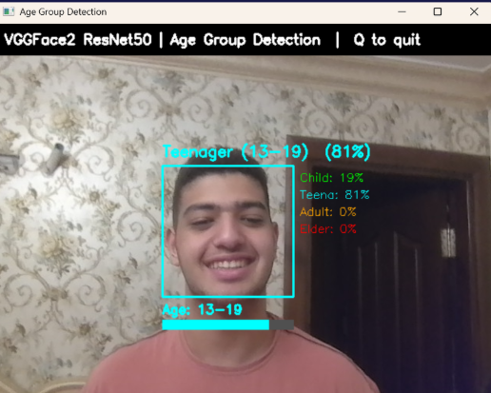
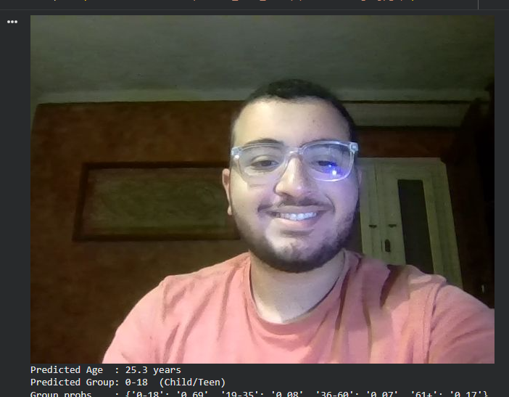
Age Recognition
Youssef Waleed - Real-Time Age Estimation
We developed two age detection models trained on the UTK-Face DataSet for age classification into 4 age groups
Model 1: Transfer learning a RESNET 50 model on age detection
Model 2 : Stage wise regression CNN that works on 2 stages , stage 1 -> classification , stage2 -> Regression
THOTH — Smart Museum Guide
24 / 00

Slide 32
Age Recognition
Youssef Waleed - Real-Time Age Estimation
Model 1
ResNet50
THOTH — Smart Museum Guide
24 / 00

Slide 33
Age Recognition
Youssef Waleed - Real-Time Age Estimation
Model 2
SSR-CNN
THOTH — Smart Museum Guide
24 / 00

Slide 34
Age Recognition
RESULTS
THOTH — Smart Museum Guide
24 / 00

Slide 35
Age Recognition
RESULTS
THOTH — Smart Museum Guide
24 / 00

Slide 36
Simulation & Navigation
Saged Khaled · Youssef Waleed · Habiba Ghoneim - Gazebo, RS 2, Maps
Environment
Custom Gazebo Sim world generated from the occupancy grid map using automated wall extraction (14 rectangular collision bodies)
Map origin aligned between RViz and Gazebo to ensure coordinate consistency across both tools
Robot & Localization
TurtleBot3 Waffle simulated in Gazebo with AMCL (Adaptive Monte Carlo Localization) for real-time pose estimation
Nav2 MPPI controller handles path planning and obstacle avoidance with tuned inflation radius for narrow museum corridors
THOTH — Smart Museum Guide
25 / 00

Slide 37
Simulation & Navigation
Saged Khaled · Youssef Waleed · Habiba Ghoneim - Gazebo, RS 2, Maps
Exhibit Navigation
3 exhibit waypoints published as colored MarkerArray on the RViz map (Tutankhamun Mask 🟡, Rosetta Stone 🔴, Royal Mummies Chamber 🔵)
Clicking any marker via the Nav2 Goal tool triggers autonomous navigation to the exact exhibit coordinates
AI Narration & Q&A
On arrival, robot plays a pre-cached exhibit narration generated — zero delay on arrival
Narration ends with an invitation for questions; detects language
Robot answers visitor questions in the same language (Arabic or English)
THOTH — Smart Museum Guide
26 / 00

Slide 38
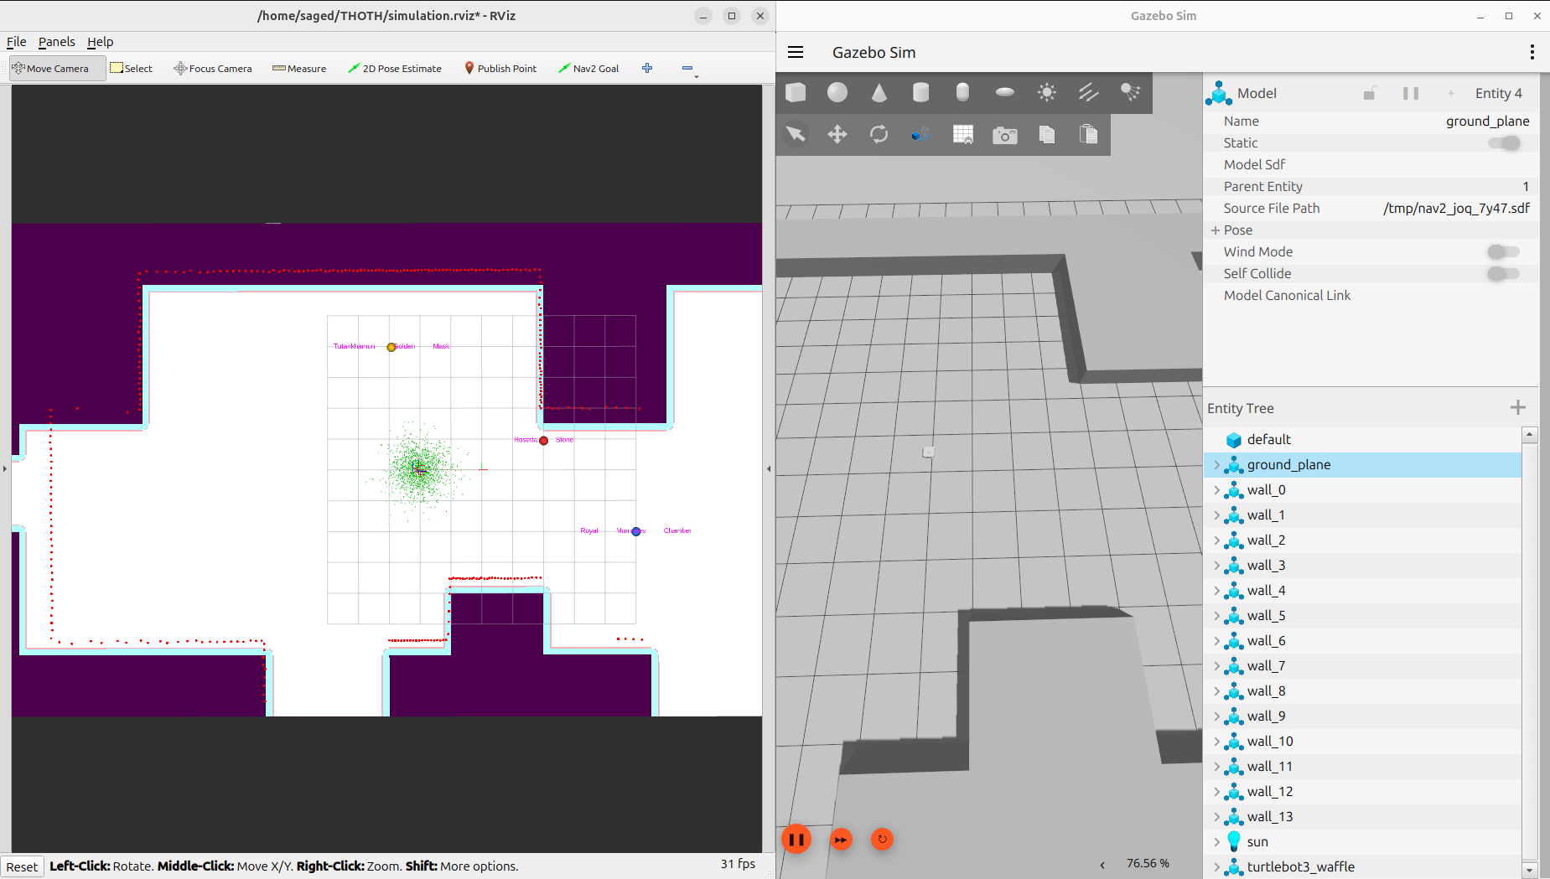
Simulation & Navigation
Saged Khaled · Youssef Waleed · Habiba Ghoneim - Gazebo, RS 2, Maps
THOTH — Smart Museum Guide
26 / 00

Slide 39
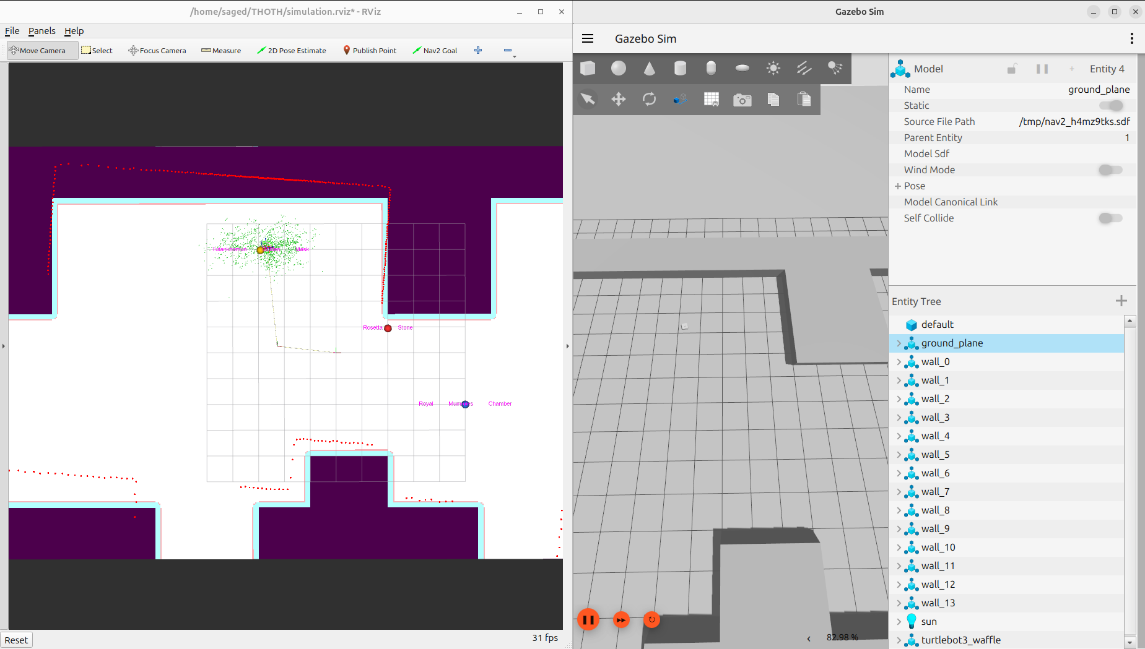
Simulation & Navigation
Saged Khaled · Youssef Waleed · Habiba Ghoneim - Gazebo, RS 2, Maps
THOTH — Smart Museum Guide
26 / 00

Slide 40
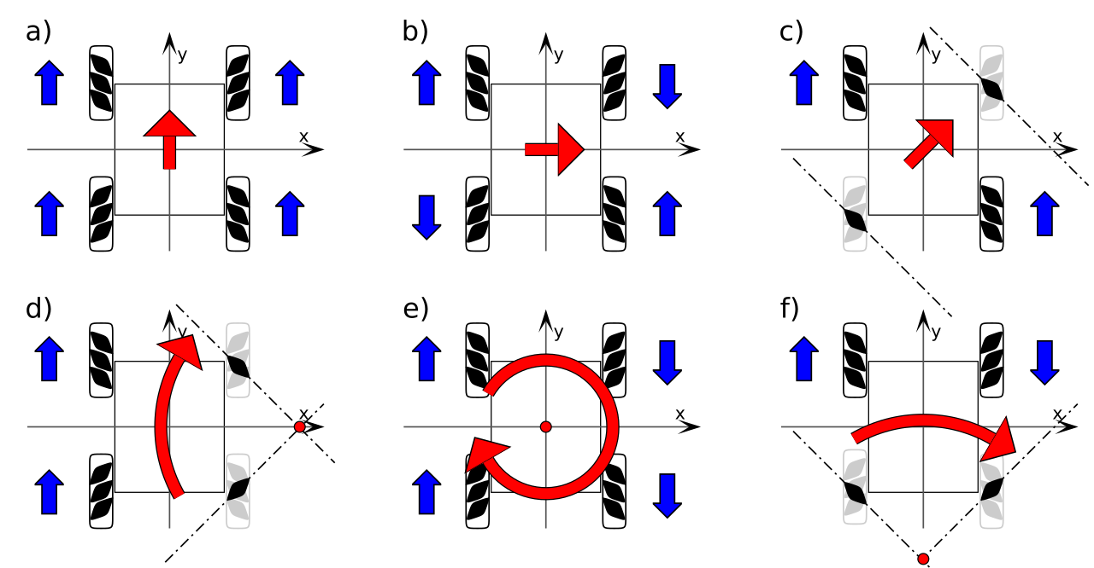
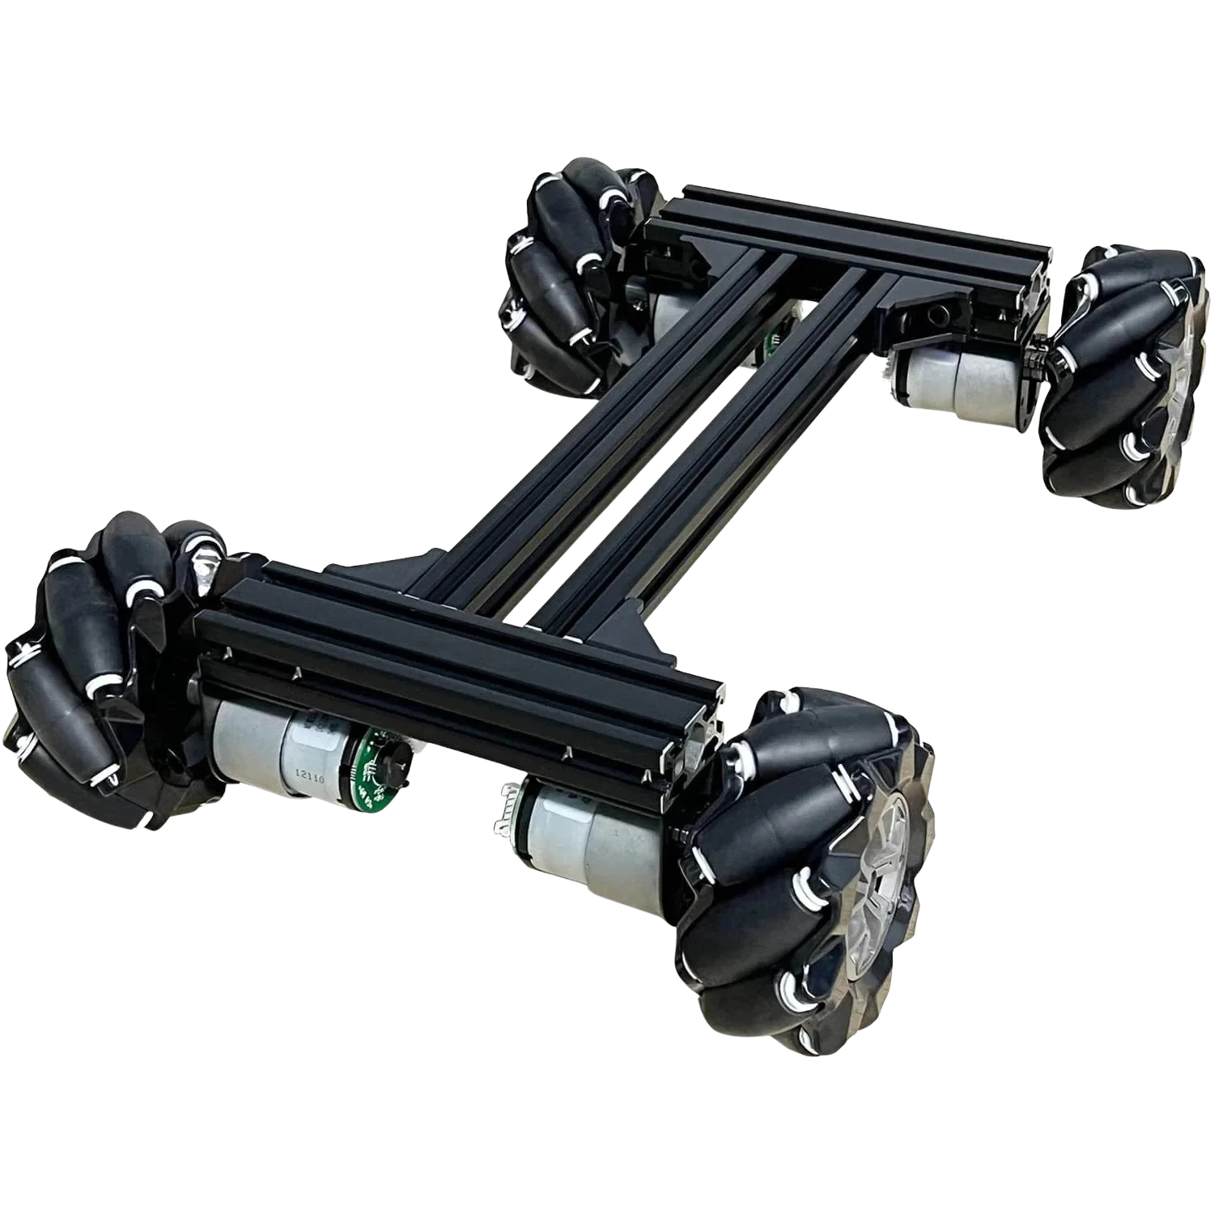
Hardware Prototype
Habiba Ghoneim · Leena Gouda - Campus Delivery Robot
THOTH — Smart Museum Guide
27 / 00
Notes:
A museum environment presents a specific navigation constraint the robot must face an exhibit while arriving at it, without a separate rotation maneuver that wastes time and disturbs visitors. Differential drive requires the robot to stop, rotate in place, then face the target. Mecanum drive lets us approach laterally and arrive already oriented toward the exhibit in a single smooth motion. For a public-facing robot where visitor experience matters, that behavioral smoothness is a real requirement, not a preference.

Slide 41
Hardware Prototype
Habiba Ghoneim · Leena Gouda - Campus Delivery Robot
The PURPOSE of this prototype was:
To validate the mechanical platform
To prove the mecanum wheel drive system works
To test basic obstacle detection using ultrasonics
What will CHANGE in Grad II:
Arduino Mega stays but becomes low-level motor controller only
Mini PC added for ROS2 high-level computation
Arduino and Mini PC communicate over serial
LiDAR added for navigation
RGB-D camera added for vision
Ultrasonic sensors stay as a safety layer (short-range collision detection)
THOTH — Smart Museum Guide
27 / 00
Notes:
In our Grad I prototype we validated the mechanical platform and basic safety behavior using encoder-based odometry and ultrasonic obstacle detection. We identified the core limitation of encoder odometry — wheel slip on mecanum wheels causes drift that accumulates over distance. This is precisely why in Grad II we replace odometry with LiDAR-based AMCL localization, which is drift-free and map-referenced.

Slide 42
Hardware Prototype (What we built)
Habiba Ghoneim · Leena Gouda - Campus Delivery Robot
Component | Specification
Chassis | 35 × 35 cm
Drive System | 4 Mecanum Wheels + 4 DC Motors
Motor Control | 2 H-Bridges + Arduino Mega
Obstacle Detection | 4 Ultrasonic Sensors (one per side)
Navigation Input | Manual target trigger (button press)
Locomotion Feedback | Encoder-based odometry
THOTH — Smart Museum Guide
27 / 00
Notes:
In our Grad I prototype we validated the mechanical platform and basic safety behavior using encoder-based odometry and ultrasonic obstacle detection. We identified the core limitation of encoder odometry — wheel slip on mecanum wheels causes drift that accumulates over distance. This is precisely why in Grad II we replace odometry with LiDAR-based AMCL localization, which is drift-free and map-referenced.

Slide 43
Hardware Prototype (What we built)
Habiba Ghoneim · Leena Gouda - Campus Delivery Robot
Component | Specification
Chassis | 35 × 35 cm
Drive System | 4 Mecanum Wheels + 4 DC Motors
Motor Control | 2 H-Bridges + Arduino Mega
Obstacle Detection | 4 Ultrasonic Sensors (one per side)
Navigation Input | Manual target trigger (button press)
Locomotion Feedback | Encoder-based odometry
THOTH — Smart Museum Guide
27 / 00
Notes:
In our Grad I prototype we validated the mechanical platform and basic safety behavior using encoder-based odometry and ultrasonic obstacle detection. We identified the core limitation of encoder odometry — wheel slip on mecanum wheels causes drift that accumulates over distance. This is precisely why in Grad II we replace odometry with LiDAR-based AMCL localization, which is drift-free and map-referenced.

Slide 44
Design constraints
THOTH — Smart Museum Guide
27 / 00

Slide 45
Project II— What's Next?
Six independent modules, all ready to integrate in Project II.
Conversational AI & Voice
Mood Recognition
Mohamed Abdallah Eldairouty
Leena Gouda
Nayrouz Ahmed
React + FastAPI + PostgreSQL. The integration layer that ties together the LLM chat, vision models (mood + age), navigation, and simulation map — one demoable system.
LLM pipeline (Gemini) + Whisper STT + edge-tts TTS. Multilingual in three languages, exhibit-aware prompts.
Real-time facial emotion recognition using OpenCV and a deep-learning model. Streams predictions to the robot brain.
Age Recognition
Simulation & Navigation
Hardware Prototype
Youssef Waleed
Saged Khaled & Youssef Waleed & Habiba Amr
Habiba Amr & Leena Gouda
Real-time age estimation from a single camera frame. Used to tune the robot's tone for kids vs. adults.
Full Gazebo museum environment and ROS 2 navigation stack — used to validate routes before hardware.
Working campus delivery robot — proves the base, motors, and control loop in real corridors.
THOTH — Smart Museum Guide
13 / 00

Slide 46
06
Business Model
THOTH — Smart Museum Guide
28 / 00

Slide 47
Business Model
Value Proposition · An always-on multilingual guide that adapts to every visitor — built for museums, but ready to serve airports, hospitals, malls, campuses, and expos with the same platform.
Revenue Streams
Target Customers
Product Sales
Maintenance & support contract
Premium exhibit content packs
Visitor analytics dashboard/Subscription based
Data monetization (selling visitor analytics to r&d firms)
Museums & heritage sites (primary — GEM)
Airports & metro stations
Academic & medical campuses
Expos, malls & smart-city installations
Cost Structure
Channels
Manufacturing
R&D
Custom domain pack (museum / airport / hospital / retail)
Maintenance & support contract
Cloud Services
Government & tourism partnerships
Trade fairs & tech expos
Pilot deployments per industry
Direct B2B sales
THOTH — Smart Museum Guide
29 / 00

Slide 48
07
Gantt Chart
THOTH — Smart Museum Guide
30 / 00

Slide 49
Project Timeline — Grad I & Grad II
Work across 12 months — Grad I delivered Feb–May, Grad II runs Jun–Jan.
Grad I
Grad II
Feb
Mar
Apr
May
Jun
Jul
Aug
Sep
Oct
Nov
Dec
Jan
Research & Lit Survey
Web App (Grad I)
AI / Voice (Grad I)
Vision (Mood + Age)
Sim & Navigation
Hardware Assembly
Full Integration
Testing in Museum
Final Demo
Completed (Grad I)
In Progress
Planned (Grad II)
THOTH — Smart Museum Guide
31 / 00

Slide 50
08
ETHICS
THOTH — Smart Museum Guide
30 / 00

Slide 51
Ethics
Concern | THOTH's Approach
Facial Data Privacy | Emotion and age detection run entirely in real-time inference — no facial images are stored, transmitted, or logged at any point
Visitor Consent | Visitors are informed via signage that the robot uses a camera; interaction is always opt-in
Inclusivity | Designed to serve all visitors — slower speech, larger text, multilingual support, and wheelchair-accessible height
Physical Safety | Robot stops immediately upon obstacle detection; operates at low safe speeds in crowded spaces; emergency stop always available
Cultural Sensitivity | Content is reviewed to ensure accurate, respectful representation of Egyptian cultural heritage
THOTH is designed with privacy-first principles — no visitor data is stored, and all AI inference happens on-device in real time.
THOTH — Smart Museum Guide
27 / 00
Notes:
In our Grad I prototype we validated the mechanical platform and basic safety behavior using encoder-based odometry and ultrasonic obstacle detection. We identified the core limitation of encoder odometry — wheel slip on mecanum wheels causes drift that accumulates over distance. This is precisely why in Grad II we replace odometry with LiDAR-based AMCL localization, which is drift-free and map-referenced.

Slide 52
Thank You
THOTH — Smart Museum Guide Robot
Questions & Discussion
github.com/MohamedEldairouty/THOTH
THOTH — Smart Museum Guide
32 / 00

